Slide 1
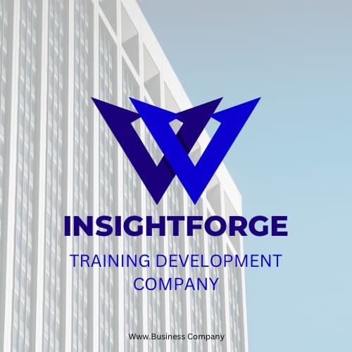

Slide 2
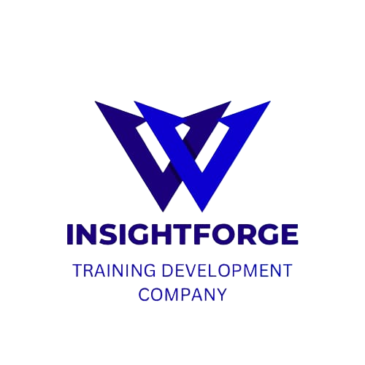
Analysis
solutions
results

Slide 3

who we are
We, InsightForge, specialize in providing comprehensive management consulting aimed at supporting companies and institutions in various administrative, technical, logistical and artistic fields.
GENERAL VIEW
3

Slide 4
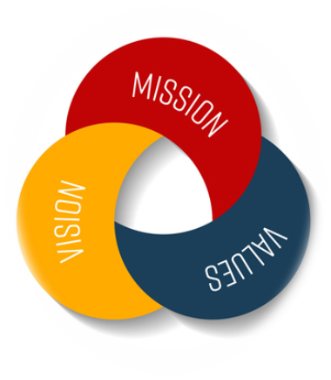

Vision- values- mission
VISION
Our vision is realized when InsightForge effectively contributes to improving the professional performance of companies by providing specialized consulting, advanced technical services, and cultural exchanges aimed at enhancing international cooperation and supporting sustainable business growth.
4

Slide 5



VALUES
Success. The company offers a range of integrated services that include strategic planning that helps in identifying long-term goals and developing a roadmap to achieve them.
Overcoming obstacles. In addition, InsightForge provides project management services to ensure the successful implementation of projects according to the specified timelines and budgets.
Efficiency & Reducing costs: The company also cares about operations management to improve operational efficiency and reduce costs.
5

Slide 6
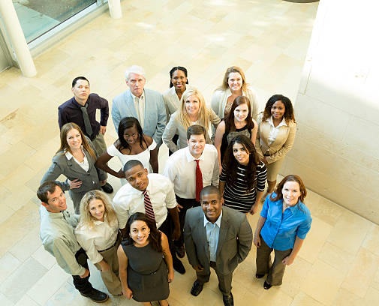
MISSION
Our mission is to focus on managing customer services to provide a distinguished customer experience that meets the needs and expectations of customers, in all areas, with high efficiency.
6

Slide 7
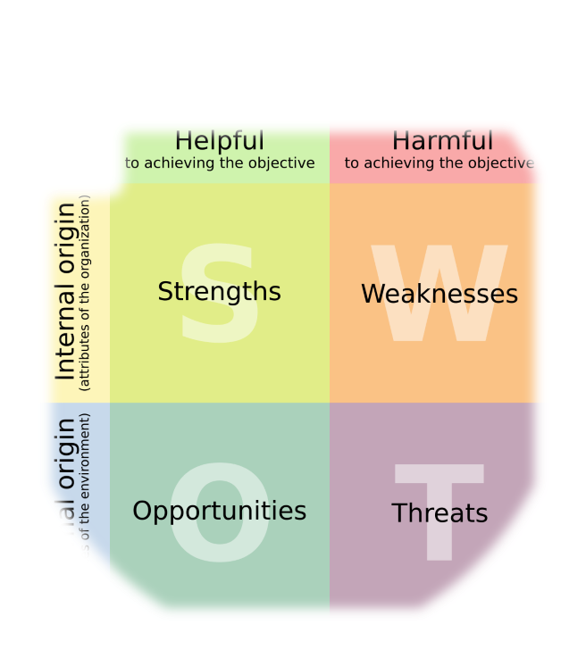

INSIGHTFORGE
METHODOLOGY
Developing effective strategies to improve internal operations and increase operational efficiency by providing the necessary advice to companies.
Identifying strengths and weaknesses in the administrative structure of companies.

Slide 8
INSIGHTFORGE
METHODOLOGY
Helping companies develop the skills of their work teams by providing training programs, workshops and organizing seminars covering administrative, technical, technological and artistic fields.
Focusing on providing innovative solutions and practical consultations that help companies achieve their goals and develop their businesses successfully.

Slide 9
INSIGHTFORGE SERVICES

Slide 10

analysis & consultants
The company provides market analysis services.
Helps companies make strategic decisions based on a thorough analysis of the current situation.
Provides innovative solutions to solve administrative problems.
Develops strategies for managing change within organizations, which contributes to improving the overall performance of companies and their adaptation to economic changes.
10

Slide 11

trademarks
In addition to consulting services, the company provides a variety of services related to establishing and managing companies, including:
Establishing trademarks,
Choosing trade names,
Providing support in dealing with government agencies.
11

Slide 12


administrational
The company also provides integrated recruitment services including:
Analyzing job needs,
Conducting interviews, evaluating candidates,
In addition to managing employee relations,
and providing wages and salaries services.
12

Slide 13


training
We provide solutions to develop enterprise management systems (ERP) and train employees to use modern systems that contribute to increasing productivity and achieving the strategic goals of companies.
13

Slide 14


technical
We are your reliable partner in providing technical programs and software customized for companies in various fields.
The company works to provide institutions with the latest technical solutions that meet their needs and help them improve their performance and develop their technological capabilities.
It also aims to integrate new systems and programming as part of
this topic by providing consultations and
training plans for employees and companies
to implement modern technological and
software systems that enhance work efficiency.
14

Slide 15
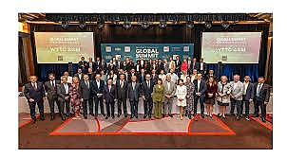
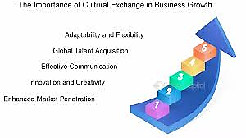
cultural
INSIGHTFORGE seeks to promote cultural exchanges by organizing international tourism trips that provide companies and entrepreneurs with the opportunity to learn about new cultures and markets, which contributes to expanding their business and building strategic relationships at the international level.
15

Slide 16


HUMAN & SUSTAINABILITY
Through human resources management, the company ensures the attraction, development and retention of talent.
It also attaches great importance to compliance and risk management to ensure compliance with laws and reduce potential risks.
In the context of its concern for the environment and society, InsightForge is committed to the principles of sustainability and corporate social responsibility.
16

Slide 17
LEARN
INVENT LEAD

